Slide 1
Temporal reinforcement learning
Slides adapted from:
Andra Geana
Jeff Cockburn
Michael Frank
Notes:
Building off what Michael discussed about learning in sequence
Interactive – chat
More algorithmic overview of these concepts

Slide 2
Assume you’re a brain
You need to eat things, you don’t want to be eaten by other things, and you’d “like” to produce more brains.
What is learning?
Why is learning important?
What should you learn?
When should you learn?

Slide 3
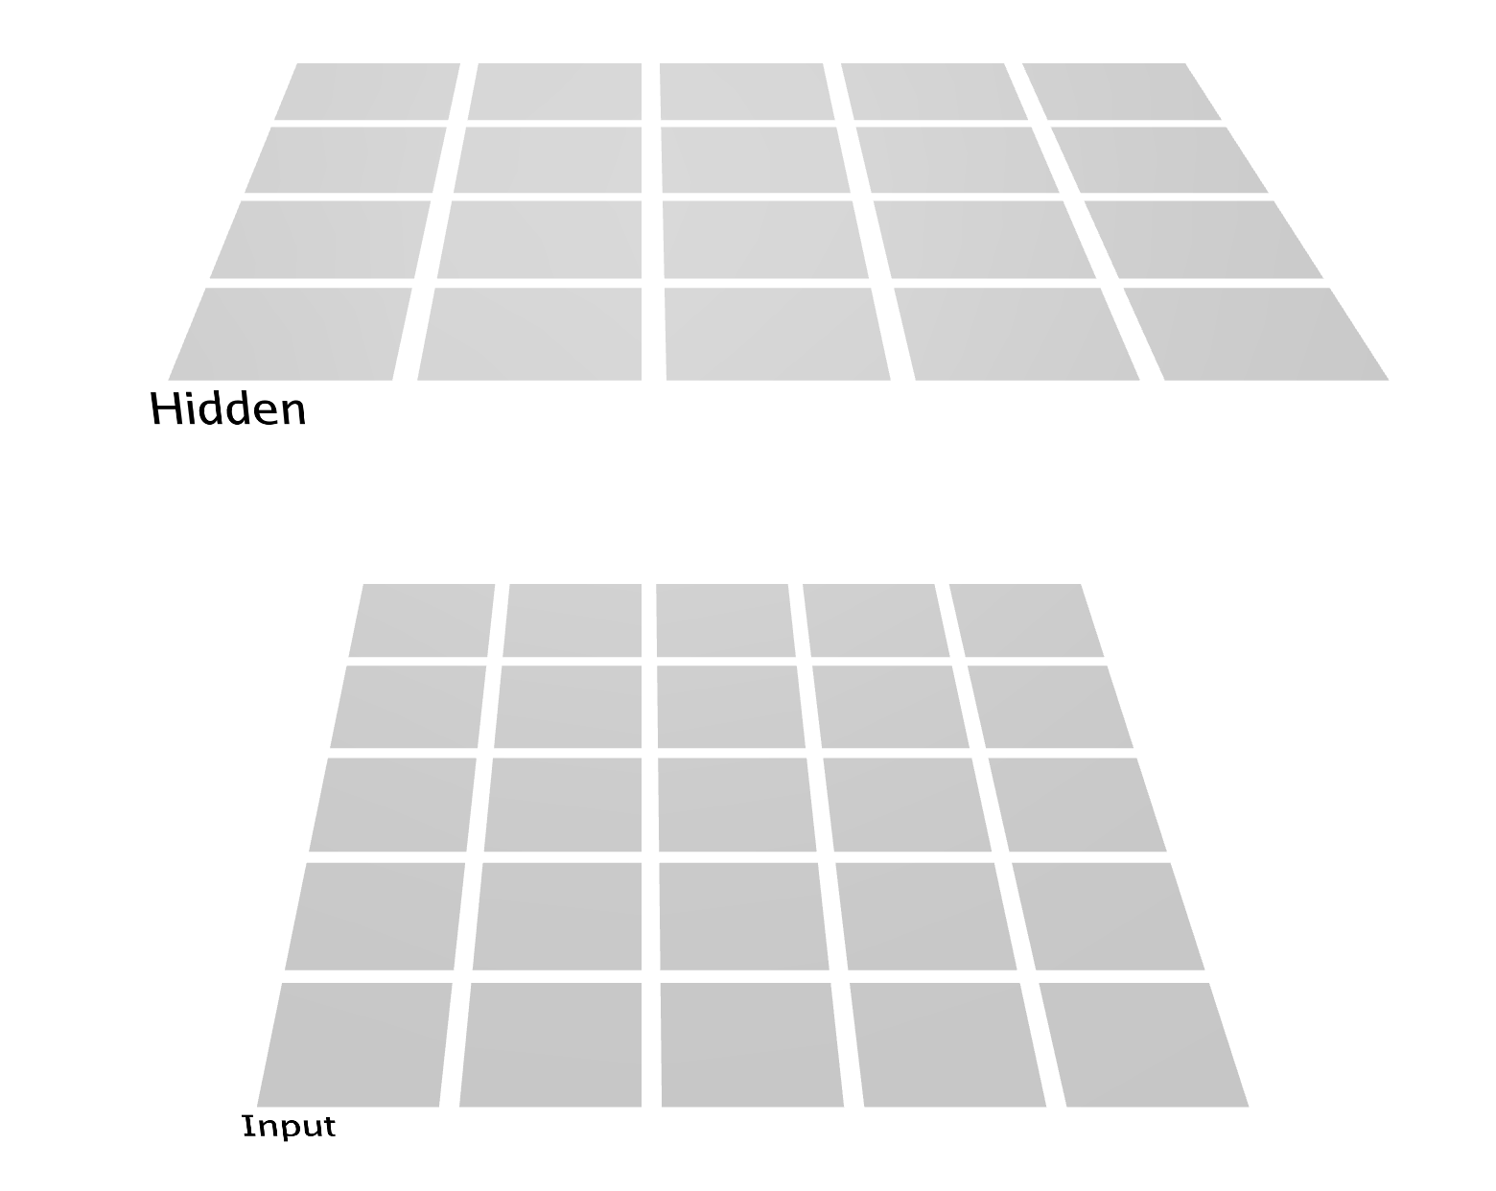
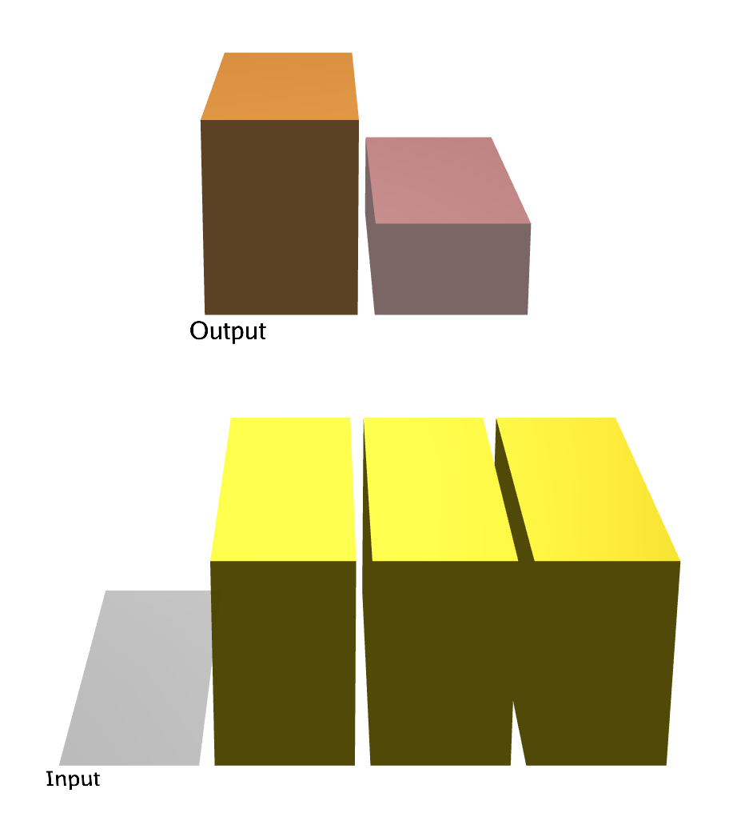
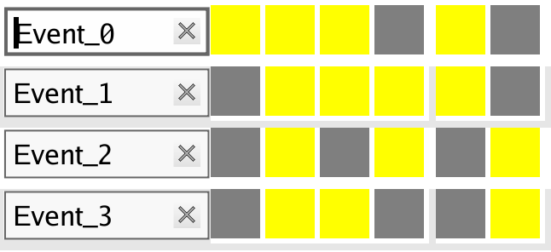
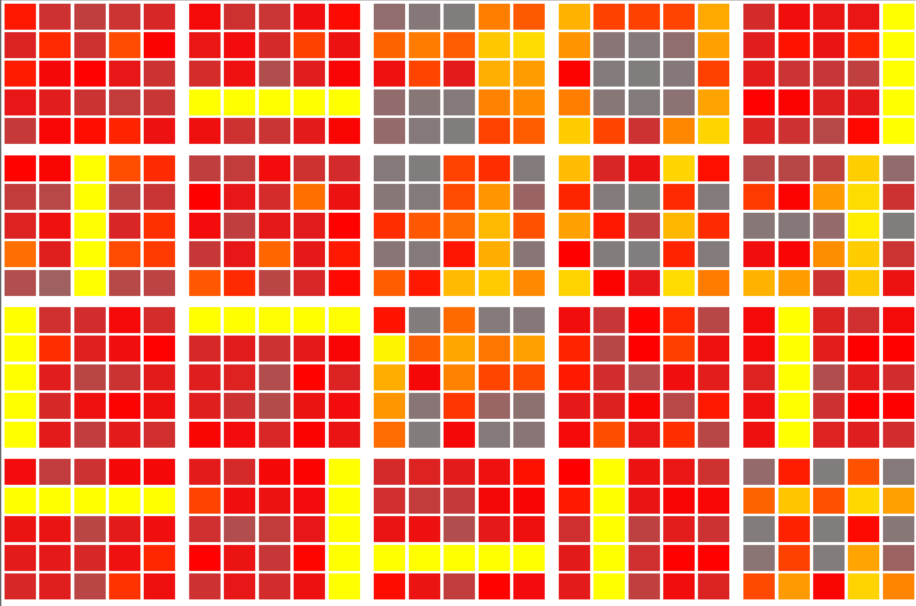
There are different types of “learning”
Learning: Remembering relationships
SUPERVISED
UNSUPERVISED
Someone tells you them (e.g. parents)
You see stuff out there

Slide 4
Learning example: SRN
Output
Clamping the output is “supervising”.
Hebbian plasticity during settling is “unsupervised”.
Hidden
Input
Context
Notes:
Example of sequences

Slide 5
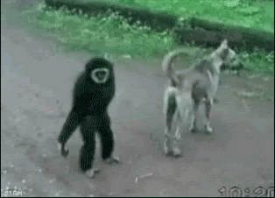
Reinforcement learning: In-between
Features:
No ‘teacher’
No ‘correct’ answer given
Only better/worse outcomes
What determines value?
Grounded in motivation
Some ‘wants’ are innate
Link events/actions to innate ‘wants’
Supervised? Un?
Link spans time!
Notes:
(you can also make sure to emphasize that for biological agents the reward signal is something they get to experinece and learn from in many cases where supervised signals about what should have been done are not available)

Slide 6
Reinforcement Learning
Reinforcement (term from operant conditioning)
Something that makes it more likely that a certain response will re-occur
Notes:
History of RL
http://www.incompleteideas.net/book/ebook/node12.html
(e.g. food, money, game points, social/legal consequences)

Slide 7
Reinforcement Learning
Reinforcement (term from operant conditioning)
Something that makes it more likely that a certain response will re-occur

Slide 8
Conditioning: training an organism to respond in specific ways to certain stimuli (shaping behavior)
Instrumental (operant):
train voluntary responses (actions)
Classical (Pavlovian):
train involuntary responses (CR)

Slide 9
Reinforcement Learning
Using trial-and-error to learn how to map situations to actions so as to maximize a numerical reward signal
Sutton & Barto, 2nd Ed, 2018
Notes:
In the long run

Slide 10
Learning about delayed outcomes
The results of actions are often delayed
Irrelevant information abounds
Want “good” results
Goal: Learn to predict event outcomes
Radio
on
Coffee on
Phone
call
Coffee
ready
E₁
E₂
E₃
O₁
Time
Referred to as: Temporal credit assignment

Slide 11
Temporal difference learning (informally)
Action
Agent
Environment
Reward,
Observation (State)
Find $1.25!
In living room
More likely to repeat?
In living room
Lift couch
cushions
Notes:
Learning process: interaction b/w agent and environment
Agent observes reward from current environment (e.g. state)
Based on observations, it updates its knowledge of the state
Based on updated knowledge, agent chooses action
Action moves agent into next state
Describes both learning and decision making

Slide 12
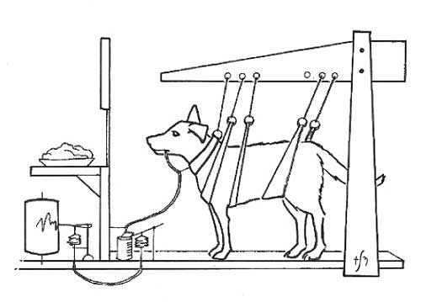
Classical Conditioning
What did Pavlov learn about what his dog learned?

Slide 13
Classical Conditioning
What did Pavlov learn about what his dog learned?
Day 1
A bell rings:
Was that: expected / unexpected ?
Is this: Better / Worse / Neutral to what you expected?
Is there anything to learn?
Food arrives:
Was that: expected / unexpected ?
Is this: Better / Worse / Neutral to what you expected?
Is there anything to learn?

Slide 14
Classical Conditioning
What did Pavlov learn about what his dog learned?
Day 2
A bell rings:
Was that: expected / unexpected ?
Is this: Better / Worse / Neutral to what you expected?
Is there anything to learn?
Food arrives:
Was that: expected / unexpected ?
Is this: Better / Worse / Neutral to what you expected?
Is there anything to learn?

Slide 15
Classical Conditioning
What did Pavlov learn about what his dog learned?
Day 3
A bell rings:
Was that: expected / unexpected ?
Is this: Better / Worse / Neutral to what you expected?
Is there anything to learn?
Food arrives:
Was that: expected / unexpected ?
Is this: Better / Worse / Neutral to what you expected?
Is there anything to learn?

Slide 16
Rescorla & Wagner (1972)
Why would you not always
want a learning rate of 1?
Prediction error or “surprise” driven learning rule
Predicted Value of state at time t
Prediction Error difference b/n observed and predicted
$$δ_{t}=r_{t}−V_{t}(s)$$
$$V_{t+1}(s)=V_{t}(s)+αδ_{t}$$
Updated Value
at time t+1 of state
Learning rate: how much do we care about each new data point?
Higher learning rates means we learn (and forget) faster!
Notes:
Emphasize difference with error driven
Animals and humans are constantly making predictions about their world so that they can plan behavior
Tracking running average of reward

Slide 17
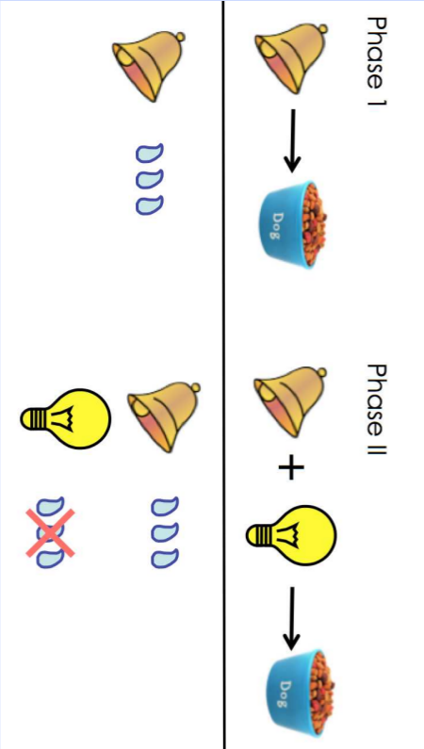
Blocking
$$δ_{t}=r_{t}−V_{t}(s)$$
$$V_{t+1}(s)=V_{t}(s)+αδ_{t}$$
?

Slide 18
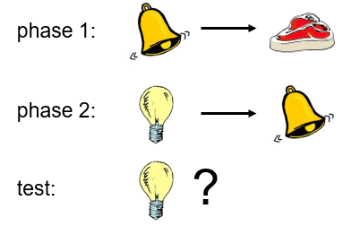
Problems with Rescorla Wagner
$$δ_{t}=r_{t}−V_{t}(s)$$
$$V_{t+1}(s)=V_{t}(s)+αδ_{t}$$
Trial-level learning and prediction
Scaling problem
Can’t explain effects like associative bias
Rats more likely to associate light and shock or flavor and poisoning
Can’t explain second order conditioning
Why?
Notes:
what would thje model predict
what do you think would happen?
Only learning from immediate award

Slide 19
How can RL handle sequences of states?
Rather than trial-level predicting based on immediate rewards,
learn to predict (discounted) future rewards!
Notes:
can think about a "good" chess position

Slide 20
Temporal difference learning (more formal)
Outcome
Predicted value
Expectations
Predicted value
Prediction Error difference b/n outcome and predicted
$$δ_{t}=r_{t}+V(s_{t+1})−V(s_{t})$$
$$V(s_{t})=V(s_{t})+αδ_{t}$$
$$V\left(s_{t+1}\right)=sum[R_{future}]$$
Notes:
Value of everything that can happen from now on!

Slide 21
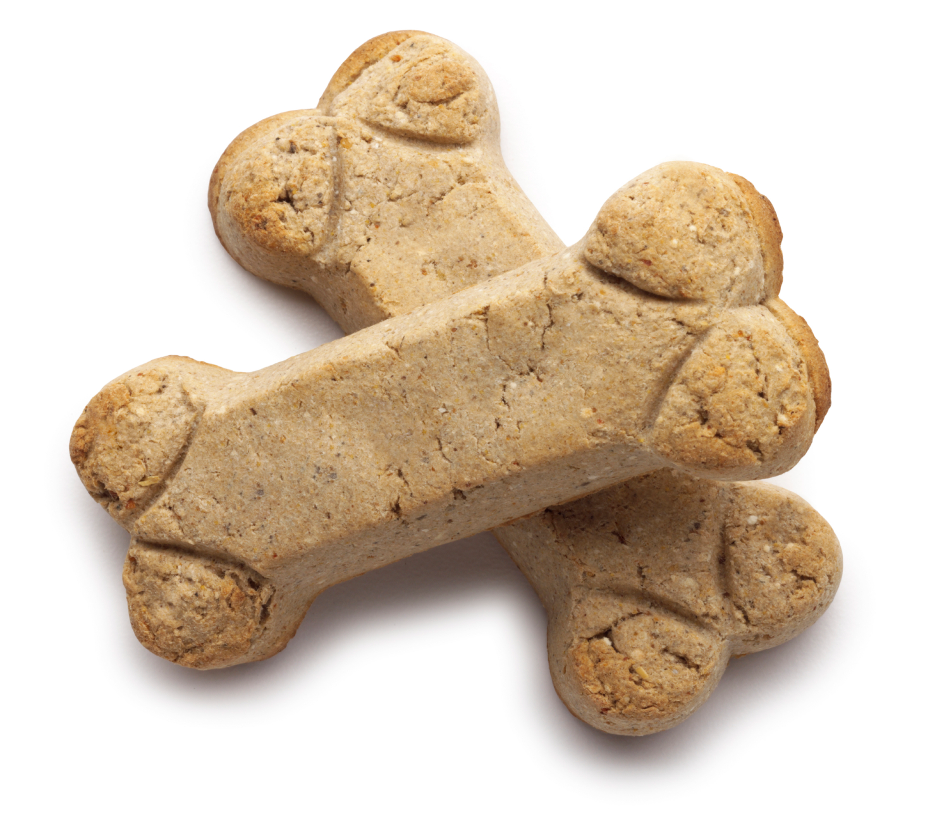
Pavlov’s dog
$$δ_{t}=r_{t}+V(s_{t+1})−V(s_{t})$$
$$V\left(s_{t}\right)←V(s_{t})+αδ_{t}$$
$$α=1$$
r=0
r=0
r=1
t = 0
t = 1
t = 2
$$V\left(S_{t}\right)=V\left( \right)= 0$$
$$V\left(S_{t+1}\right)=V\left( \right)=0$$
$$δ=0+0−0=0$$
$V\left( \right)$ = 0
$$V\left(S_{t}\right)=V\left( \right)=0$$
$$V\left(S_{t+1}\right)=V\left( \right)=0$$
$$δ=0+0−0=0$$
$V\left( \right)$ = 0
$$V\left(S_{t}\right)=V\left( \right)=0$$
$V\left(S_{t+1}\right)=$ None
$$δ=1−0=1$$
$V\left( \right)$ = 1
V V V
0 0 1

Slide 22
Pavlov’s dog
$$δ_{t}=r_{t}+V(s_{t+1})−V(s_{t})$$
$$V\left(s_{t}\right)←V(s_{t})+αδ_{t}$$
$$α=1$$
r=0
r=0
r=1
t = 0
t = 1
t = 2
$$V\left(S_{t}\right)=V\left( \right)=0$$
$$V\left(S_{t+1}\right)=V\left( \right)=0$$
$$δ=0+0−0=0$$
$V\left( \right)$ = 0
$$V\left(S_{t}\right)=V\left( \right)=0$$
$$V\left(S_{t+1}\right)=V\left( \right)=1$$
$$δ=0+1−0=1$$
$V\left( \right)$ = 1
$$V\left(S_{t}\right)=V\left( \right)=1$$
$V\left(S_{t+1}\right)=$ None
$$δ=1−1=0$$
$V\left( \right)$ = 1
V V V
0 0 1
0 1 1

Slide 23
Pavlov’s dog
$$δ_{t}=r_{t}+V(s_{t+1})−V(s_{t})$$
$$V\left(s_{t}\right)←V(s_{t})+αδ_{t}$$
$$α=1$$
r=0
r=0
r=1
t = 0
t = 1
t = 2
$$V\left(S_{t}\right)=V\left( \right)=0$$
$$V\left(S_{t+1}\right)=V\left( \right)=1$$
$$δ=0+1−0=1$$
$V\left( \right)$ = 1
$$V\left(S_{t}\right)=V\left( \right)=1$$
$$V\left(S_{t+1}\right)=V\left( \right)=1$$
$$δ=0+1−1=0$$
$V\left( \right)$ = 1
$$V\left(S_{t}\right)=V\left( \right)=1$$
$V\left(S_{t+1}\right)=$ None
$$δ=1 −1=0$$
$V\left( \right)$ = 1
V V V
0 0 1
0 1 1
1 1 1
”bootstrapping”
Uses own estimation of future reward to learn even in the absence of immediate reward
Notes:
Can use other stimuli to “bootstrap” learning
There’s an issue here….what happens if this sequence is really long?
- Farther away in time from the reward
typo slifde

Slide 24
Consider a long sequence
…
t = 0
t = 1
t = 100
$$δ_{t}=r_{t}+ V(s_{t+1})−V(s_{t})$$
$$V(s_{t})=V(s_{t})+αδ_{t}$$
If $V\left(s_{t+1}\right)=sum[R_{future}]$
You are guaranteed all the kibbles…100 time points from now

Slide 25
Consider a long sequence
…
t = 0
t = 1
t = 100
$$δ_{t}=r_{t}+ γV(s_{t+1})−V(s_{t})$$
$$V(s_{t})=V(s_{t})+αδ_{t}$$
Solution: discount the value of future reward!
V(s_{t}) = sum of discounted rewards
= r_{t+1}+ 𝛾r_{t+2} + 𝛾²r_{t+3} + 𝛾³r_{t+4} + …

Slide 26
Pavlov’s dog
$$δ_{t}=r_{t}+γV(s_{t+1})−V(s_{t})$$
$$V\left(s_{t}\right)←V(s_{t})+αδ_{t}$$
$$α=1$$
$$γ=0.5$$
r=0
r=0
r=1
t = 0
t = 1
t = 2
$$V\left(S_{t}\right)=V\left( \right)=0$$
$$V\left(S_{t+1}\right)=V\left( \right)=0$$
$$δ=0+(0.5)0−0=0$$
$V\left( \right)$ = 0
$$V\left(S_{t}\right)=V\left( \right)=0$$
$$V\left(S_{t+1}\right)=V\left( \right)=0$$
$$δ=0+(0.5)0−0=0$$
$V\left( \right)$ = 0
$$V\left(S_{t}\right)=V\left( \right)=0$$
$V\left(S_{t+1}\right)=$ None
$$δ=1−0=1$$
$V\left( \right)$ = 1
V V V
0 0 1

Slide 27
Pavlov’s dog
$$δ_{t}=r_{t}+γV(s_{t+1})−V(s_{t})$$
$$V\left(s_{t}\right)←V(s_{t})+αδ_{t}$$
$$α=1$$
$$γ=0.5$$
r=0
r=0
r=1
t = 0
t = 1
t = 2
$$V\left(S_{t}\right)=V\left( \right)=0$$
$$V\left(S_{t+1}\right)=V\left( \right)=0$$
$$δ=0+(.5)0−0=0$$
$V\left( \right)$ = 0
$$V\left(S_{t}\right)=V\left( \right)=0$$
$$V\left(S_{t+1}\right)=V\left( \right)=1$$
$$δ=0+.5\left(1\right)−0=.5$$
$V\left( \right)$ = 0.5
$$V\left(S_{t}\right)=V\left( \right)=1$$
$V\left(S_{t+1}\right)=$ None
$$δ=1−1=0$$
$V\left( \right)$ = 1
V V V
0 0 1
0 0.5 1

Slide 28
Pavlov’s dog
$$δ_{t}=r_{t}+γV(s_{t+1})−V(s_{t})$$
$$V\left(s_{t}\right)←V(s_{t})+αδ_{t}$$
$$α=1$$
$$γ=0.5$$
r=0
r=0
r=1
t = 0
t = 1
t = 2
$$V\left(S_{t}\right)=V\left( \right)=0$$
$$V\left(S_{t+1}\right)=V\left( \right)=0.5$$
$$δ=0+\left(.5\right).5−0=.25$$
$V\left( \right)$ = .25
$$V\left(S_{t}\right)=V\left( \right)=0.5$$
$$V\left(S_{t+1}\right)=V\left( \right)=1$$
$$δ=0+\left(.5\right)1−.5=0$$
$V\left( \right)$ = 0.5
$$V\left(S_{t}\right)=V\left( \right)=1$$
$V\left(S_{t+1}\right)=$ None
$$δ=1 −0=0$$
$V\left( \right)$ = 1
V V V
0 0 1
0 0.5 1
.25 .5 1
Notes:
Can use other stimuli to “bootstrap” learning
There’s an issue here….what happens if this sequence is really long?
- Farther away in time from the reward

Slide 29
TD-Learning
Value of state expressed in future expected rewards
$$V_{t}=E\left[\sum_{i=t}^{T}{γ^{i−t}r_{i}}\right]{= E[γ}^{0}r_{t}+γ^{1}r_{t+1 }+γ^{2}r_{t+2} …]$$
${= E[γ}^{0}r_{t}]+γE[r_{t+1 }+γ^{1}r_{t+2} …]$
$=E[r_{t}]+γV_{t+1}$
$$δ_{t}=r_{t}+γ{\hat{V}}_{t+1}(s)−\hat{V_{t}}(s)$$
$${\hat{V}}_{t+1}\left(s\right)=\hat{V_{t}}\left(s\right)+αδ_{t}$$
“Bellman Equation”
“temporal difference”
Notes:
Ignore actions for a second
Bellman – because of markovian property, can express future discounted value in close-form recursive definition

Slide 30
That’s cool, Alana, but what about the brain?

Slide 31
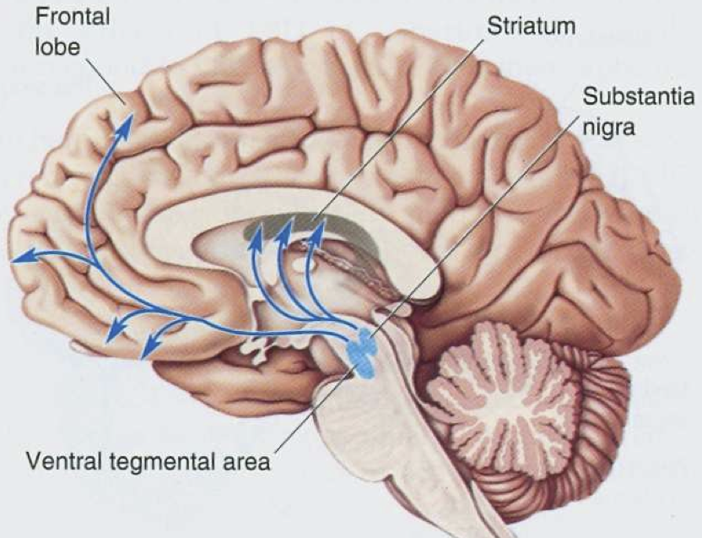
RL in the brain: Dopamine system
Notes:
Several dopamine pathways:
•Reward (VTA -> NAcc)
•Executive (VTA -> PFC)
•Motor (SNc -> striatum)
Each linked to different cognitive and psychopathology phenomena
Parkinson’s Disease
Motor control + initiation?
Intracranial self-stimulation;
Drug addiction;Natural rewards
Reward pathway?
Learning?
Also involved in:
•Working memory
•Novel situations
•ADHD
•Schizophrenia
•…

Slide 32
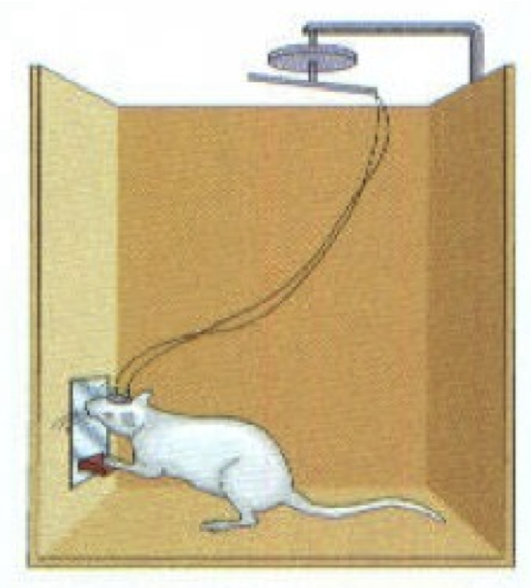
What is dopamine doing?
Dopamine carries the brain's reward signal
Wise & Rompert, 89

Slide 33
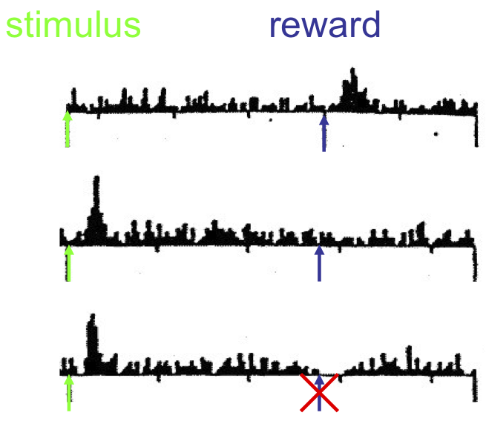
What is dopamine doing?
Dopamine carries the brain's reward signal
Wise & Rompert, 89
Schultz et. al, 98

Slide 34
What is dopamine doing?
Dopamine carries the brain's reward signal
Wise & Rompert, 89
Schultz et. al, 98

Slide 35
What is dopamine doing?
Dopamine carries the brain's reward signal
Wise & Rompert, 89
Schultz et. al, 98

Slide 36
What is dopamine doing?
Dopamine carries the brain's reward signal
reward prediction error
Wise & Rompert, 89
Schultz et. al, 98

Slide 37
What is dopamine doing?
Dopamine carries the brain's reward signal
reward prediction error
Wise & Rompert, 89
Schultz et. al, 98

Slide 38
Pavlov’s dog
$$δ_{t}=r_{t}+γV(s_{t+1})−V(s_{t})$$
$$V\left(s_{t}\right)←V(s_{t})+αδ_{t}$$
$$α=1$$
$$γ=0.5$$
r=0
r=0
r=1
t = 0
t = 1
t = 2
$$V\left(S_{t}\right)=V\left( \right)=0$$
$$V\left(S_{t+1}\right)=V\left( \right)=0.5$$
$$δ=0+\left(.5\right).5−0=.25$$
$V\left( \right)$ = .25
$$V\left(S_{t}\right)=V\left( \right)=0.5$$
$$V\left(S_{t+1}\right)=V\left( \right)=1$$
$$δ=0+\left(.5\right)1−.5=0$$
$V\left( \right)$ = 0.5
$$V\left(S_{t}\right)=V\left( \right)=1$$
$V\left(S_{t+1}\right)=$ None
$$δ=1 −0=0$$
$V\left( \right)$ = 1
V V V
0 0 1
0 0.5 1
.25 .5 1
Notes:
Can use other stimuli to “bootstrap” learning
There’s an issue here….what happens if this sequence is really long?
- Farther away in time from the reward

Slide 39
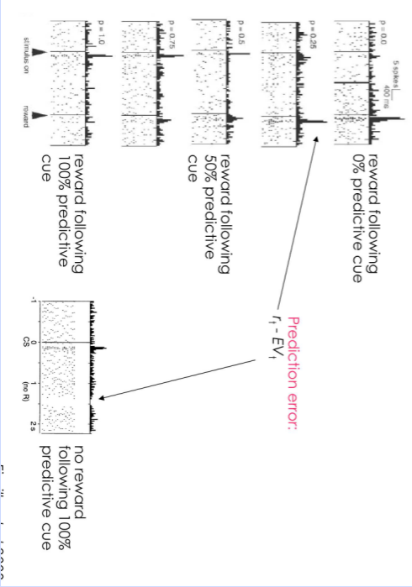
PE-hypothesis of DA
Should be sensitive to probability of reward and magnitude of reward
Tobler et al, 2005
Fiorillo et al, 2003

Slide 40
Blocking returns
?

Slide 41
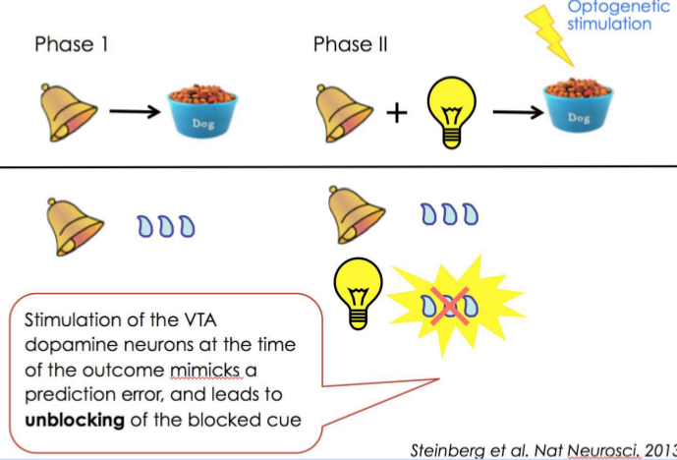
Blocking: DA induces learning

Slide 42
How are dopamine-based RPE signals used to select actions?
Will consider biological implementation in basal ganglia later

Slide 43
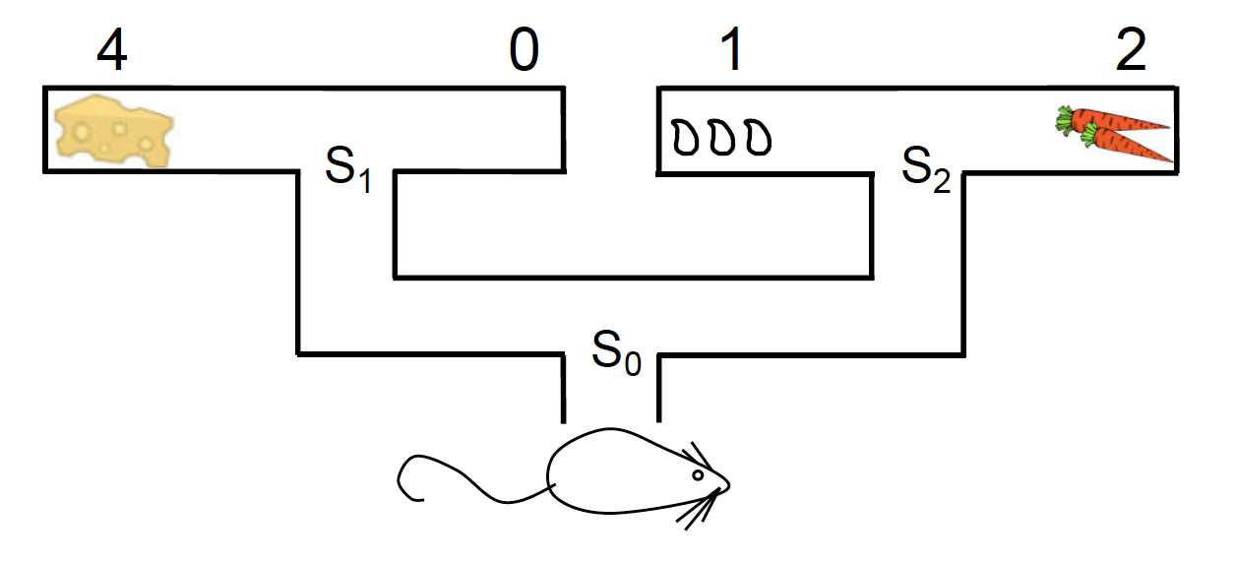
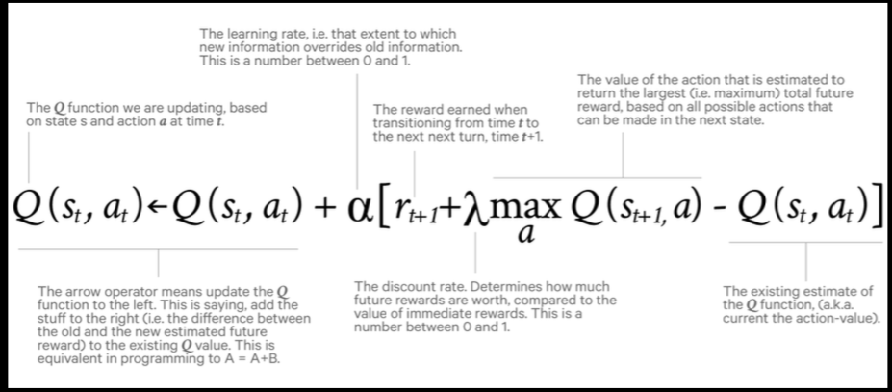
Q-Learning
Alternative - SARSA: takes into account actual choice on next time step, “on policy”
Notes:
Get by rearranging value bellman equation, some forms easier to work with than others
What are the state-action pairs that you are learning about here?
Sarsa – on policy
Maybe here draw out Q-learning going to cheese

Slide 44
Learning which actions to take
Critic
Actor
V(s_{t})
expected value of
being in state s_{t}
Q(s_{t},a_{t})
preference (weight) for
taking action a_{t} in state s_{t}
Analogy: Player/coach

Slide 45
Learning which actions to take
Critic
Actor
V(s_{t})
expected value of
being in state s_{t}
Q(s_{t},a_{t})
preference (weight) for
taking action a_{t} in state s_{t}
1) $δ_{t}=r_{t}+γV\left(s_{t+1}\right)−V\left(s_{t}\right)$
$$2) V\left(s_{t}\right)←V\left(s_{t}\right)+δ_{t}$$
$3) Q\left(s_{t}, a_{t}\right)← Q\left(s_{t}, a_{t}\right)+δ_{t}$

Slide 46
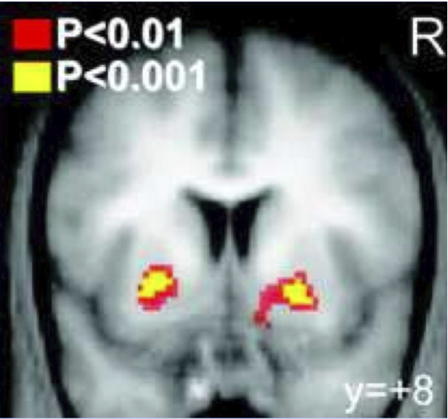
fMRI & reward prediction errors
Ventral striatum correlates with reward prediction error: Critic!
Dorsal striatum correlates when actor involved
O'Doherty et al, 2004

Slide 47
Google Deep Mind RL Network (“DQN”) Plays Atari

Slide 48
Assume you’re a brain - revisited
You still need to eat things, you still don’t want to be eaten by other things, and you’d still “like” to produce more brains.
What is learning?
Why is learning important?
What should you learn?
When should you learn?

